Slide 1
Chapter 11. New defenses
Analytics and threat intelligence to detect attacks. SIEM. Deception-based defenses. Honeypots. Zone isolation. Ecosystem attestation

Slide 2

Threat/security intelligence
Information used to automatically detect threats and react to them.
“It is the knowledge about adversaries and their motivations, intentions, and methods that is collected, analyzed, and disseminated in ways that help security staff protect the critical assets of the enterprise.”
This information includes IP addresses, domain names, DNS servers, URLs, file names, network signatures, attack patterns, actor profiles,…
This information must be analyzed and combined with information about attacker’s tools, methods, and infrastructure, honeypots,…
Technologies like big data and AI (machine learning) may be used
SIEM systems aggregate and analyze this data

Slide 3
Defenses: SIEM
Security Information and Event Management (SIEM) software products and services combine security information management (SIM) and security event management (SEM). They provide real-time analysis of security alerts generated by network hardware, IDS, and applications.
Vendors sell SIEM as software, as appliances or as managed services; these products are also used to log security data and generate reports for compliance purposes.
The product capabilities include gathering, analyzing and presenting information from network and security devices, identity and access-management applications, vulnerability management and policy-compliance tools, operating-system, database and application logs, external threat data

Slide 4
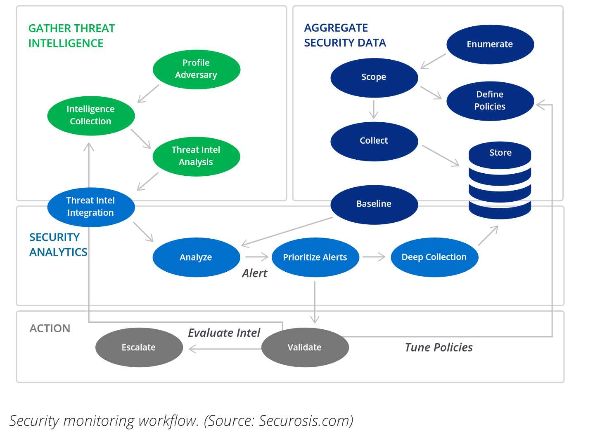

Slide 5
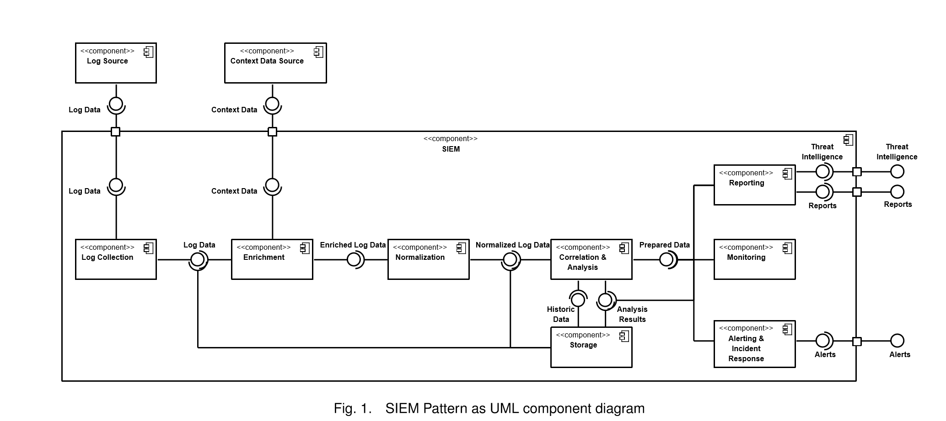

Slide 6
SIEM components
The ﬁrst module is responsible for log collection and for providing the collected log data to further modules. The input data can be provided by various log sources.
The enrichment component uses context data for providing additional information for bare log data in order to improve further processing by providing enriched log data. Various context data sources supply the needed data.
For enabling and facilitating further processing, the data is restructured into a standardized format (normalized log data) in the normalization component.
The main part is the correlation and analysis component, as there the incidents are ﬁnally recognized based on the incoming normalized log data.
Additionally, analyses are conducted based on historic data provided by the storage component. Analysis results and raw log data are also stored herein. In order to enable further processing by other modules, prepared data is provided.
Finally, the ﬁndings can either be reported or shared with other systems or organizations in form of threat intelligence.
The monitoring component provides an interface for human interaction and the alerting & incident response component can propagate alerts to responsible stakeholders or react automatically in case of an incident

Slide 7
Deception defenses
Deception is “Planned actions taken to mislead and/or confuse attackers and to thereby cause them to take (or not take) specific actions that aid computer-security defenses.”
A common type are honeypots
More advanced methods have appeared recently

Slide 8
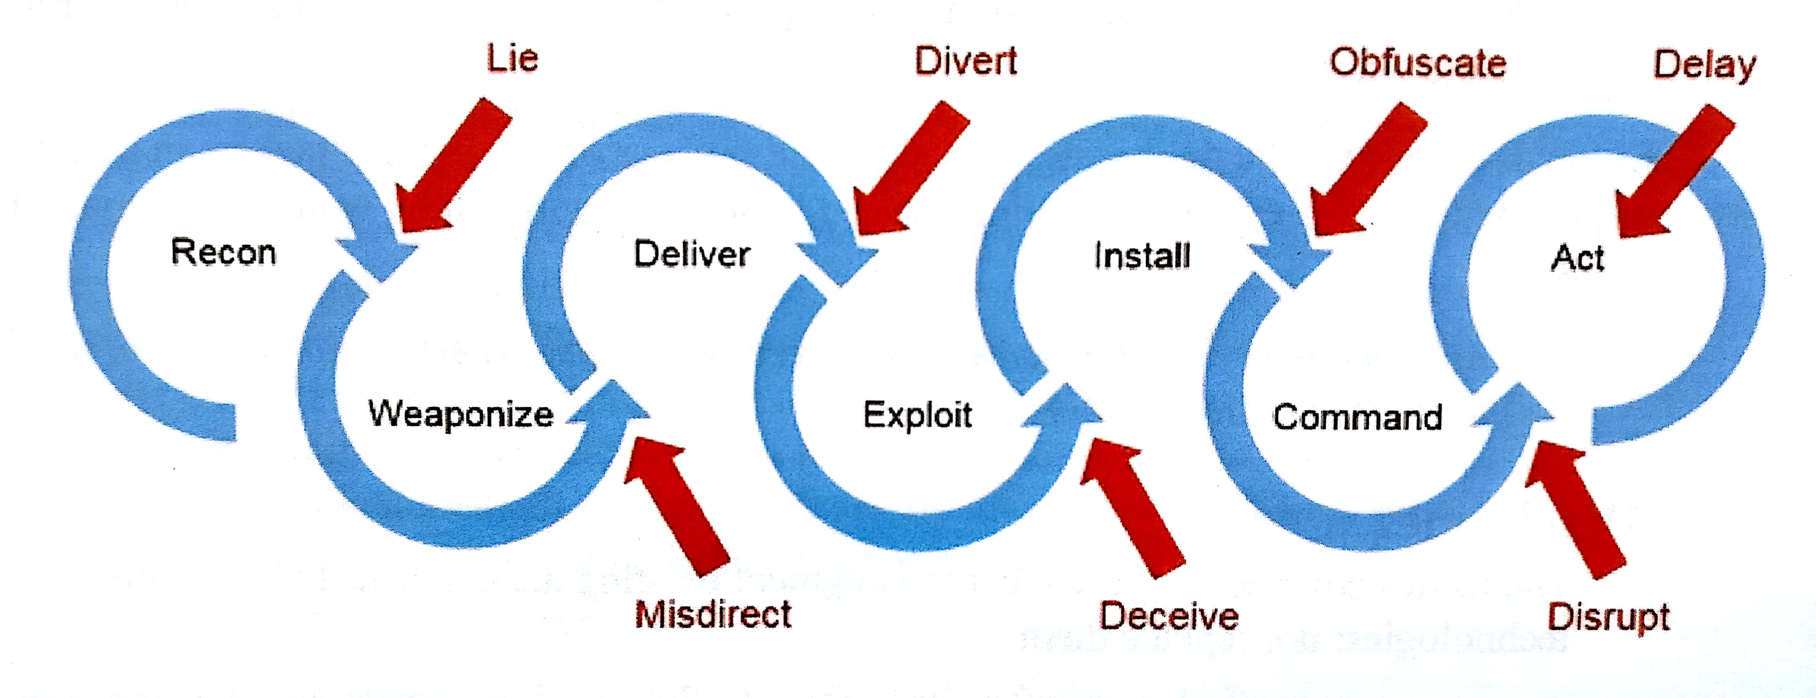
Active defense and deception in the CKC

Slide 9
Honeypots
Intent
Attract attacks generated by intruders to understand and capture their intentions, mechanisms, strategies and potential for success in order to prepare better to defend against these attacks. Attackers are lured by mimicking internal, typically sensitive services.
Solution
Place an easy and appealing target, a honeypot, to attract attacks and lure intruders, so we can assess (i.e., infer, characterize, mitigate, and attribute) them and prepare ways to halt them.
A honeypot, when configured with services operating in such realms, could be used to capture significant attack strategies, intentions and mechanisms to aid in deriving effective attack signatures that can be used for detection, mitigation, and attribution, as well as to indicate possible defenses.

Slide 10
Attacker
attackService
Honeypot
requestService
Server
*
1
1
*
*
*
Service
Proxy
simulates
Service
1
1
*
redirectAttacks
1
Attack
Detector
*
1
1
Alert
Log
Attack
Signature
Catalog
1
1
*
Report
*
Signature

Slide 11
Solution
The figure shows the class diagram of this pattern. The Honeypot includes several Service Proxies that represent real Services provided by the local Server. When the Attacker attempts to access any of these proxies the Attack Detector captures its Signature which is placed in the Attack Signature Catalog. The Attack Detector activates an Alert for the system administrator and keeps a Log of each event received during the attack. Reports are generated at periodic intervals from the Log.

Slide 12
Sequence diagram for use case Detect Attack

Slide 13
Honeypot consequences
Extensibility and Flexibility—a honeypot is able to mimic diverse and tailored services to increase the detection rate.
Usability—a well-thought interface can achieve usability.
Legitimacy as network assets/resource—the honeypot will increase its detection rate by optimizing its deception characteristics.
Mingling Factor—the honeypot will lure more attackers, which also increases its detection and protection rate.
Exploitation resilience—the honeypot will be able to handle more attackers, thus increasing its protection rate.
Alerting and Logging—the honeypot will be able to effectively alert concerned parties about an ongoing attack for effective mitigation and use logged data for future planning.
Reporting-- the honeypot will be able to generate cyber threat intelligence that can effectively be used in long-term analysis and actionable thwarting of attacks.

Slide 14
Autonomous cyber defense systems [Doc15]
The basis for an autonomous cyber defense system is comprised largely of the defended network itself, potentially without significant dedicated resources
Therefore, the system must be flexible in supporting configurations with and without dedicated resource pools; and also able to operate in a heterogeneous, dynamically changing environment with mixed levels of trust
Crosbie and Spafford presented characteristics desirable for an intrusion detection system: run continually, fault tolerant, resist subversion, minimal overhead, configurable, adaptable, scalable, graceful degradation of service and dynamic reconfiguration – all of which are applicable to autonomous cyber defense systems in general.

Slide 15
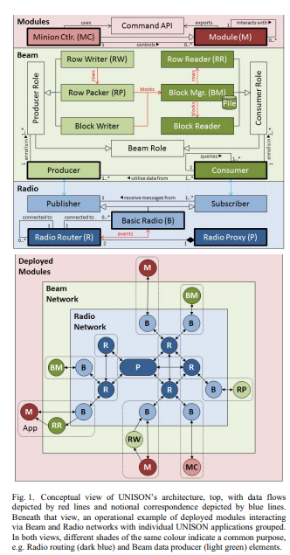

Slide 16
UNISON layers
Radio: provides asynchronous messaging services using a topic-based, distributed publish/subscribe pattern, where individual system entities can communicate information in a many-to-many fashion (event publication) and receive information based on interest (event topic subscription)
Beam: The middle layer provides data distribution and persistence services using a distributed producer/consumer model aligned with Radio’s topic-based subscription model, whereby blocks of key-value data are stored (in memory or on disk), requested, produced (published) and consumed (received via subscription) according to data topics. Data topics determine not only the block dissemination strategy but also the spatial distribution of data.

Slide 17
UNISON layers II
Modules: The third layer provides a consistent interface to Beam and Radio for application-specific deployable UNISON modules – essentially software agent-like components which can communicate to achieve a common goal.
The layer also includes a specific module called a Minion controller for achieving local control of a host, coordinating other modules (such as sensors, actuators and decision elements in an autonomous cyber defence system) and local Beam and Radio components.

Slide 18
A use case for UNISON
Policy: All port scans are prohibited (except by admins).
If this policy is breached the system can kill the offending processes, lock the account of the offending user, quarantine the offending machine via network isolation (firewalls), or shutdown the offending machine.
These actions are performed by actuator modules which receive commands from control modules and which in turn are informed by sensor modules (detect port scan).
UNISON is clearly a control system to enforce policies.

Slide 19
Deception attacks
In the same way that we hve deception defenses we also have deception attacks.
These attacks are intended to confuse a system, including its users, and make it commit errors.
Many CPS attacks produce confusion in systems or people, which can result in the physical destruction of buildings, vehicles, equipment or the killing of people.
A good example is plane crashes produced by wrong altitude and speed measurements.
We saw a robotics attack that confused a robot which then would not stop in the presence of a human

Slide 20
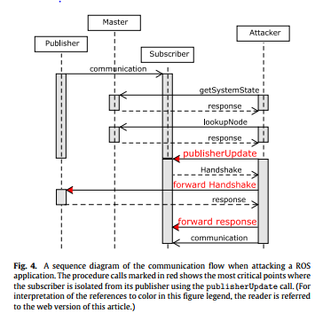
Publish/subscribe attacks in robots

Slide 21
Deception attacks in the US elections
Announcements telling voters to use fake sites for registration
Announcements giving wrong places or times of voting, pictures showing long lines to discourage voters
Announcements that voting has closed or that ICE agents were arresting voters
Announcements that you could vote using the Internet
Conspiracy theories about candidates or parties
Conflicting announcements about who won or about possible fraud to create mistrust in the voting process

Slide 22
Cambridge Analytica
Was a political consultancy hired by President Trump’s campaign and other Republicans
Had improperly gathered detailed Facebook information on 87 million people, of whom 71 million were Americans
Relied on different techniques and was more detailed and extensive than what the hackers collected using Facebook’s search functions
Data set included user names, hometowns, work and educational histories, religious affiliations and Facebook “likes” of users and their friends, among other data.
Other users affected were in countries including the Philippines, Indonesia, U.K., Canada and Mexico
The illicit harvesting of personal data by Cambridge Analytica was first reported in December 2015

Slide 23
Cambridge Analytica II
Facebook claimed only 270,000 people had responded to a survey app created by a researcher in 2014. The researcher was able to gather information on the friends of the respondents without their permission, vastly expanding the scope of his data. That researcher then passed the information on to Cambridge Analytica.
The real number of affected people was more than 87 million profiles.
Cambridge Analytica used an algorithm capable of psychologically profiling users from their Facebook interactions alone, to be more specific, it used the ‘Big Five’ Personality test, and then it targeted hundreds of political adverts everyday to the specific personality types, tailored towards people’s innermost fears, needs, and emotions.
For more details, see: https://www.bbc.com/news/av/technology-43674480/facebook-data-how-it-was-used-by-cambridge-analytica

Slide 24
Cambridge Analytica
References:
https://www.washingtonpost.com/news/the-switch/wp/2018/04/04/facebook-said-the-personal-data-of-most-its-2-billion-users-has-been-collected-and-shared-with-outsiders/?noredirect=on&utm_term=.b73898f99cc0
https://en.wikipedia.org/wiki/Facebook%E2%80%93Cambridge_Analytica_data_scandal
https://www.bbc.com/news/av/technology-43674480/facebook-data-how-it-was-used-by-cambridge-analytica

Slide 25
zone Isolation using Virtual processors
Intent: Provide two execution environments: one is intended to support the standard functions of phones: make phone calls, take pictures, store lists of contacts. The other is intended for business functions such as accessing databases, development environments, and employee email. Another use of the more secure zone is the execution of sensitive functions. The separation is performed by creating two types of strictly separated virtual processors.
Also known as
Isolation using virtual machines, virtual zones, virtual worlds, trustzone
Context
Corporate databases contain data that may be valuable because they include information about business plans, customer medical records, and similar. We want our employees to have access to these resources according to their business functions. People want to use their smart phones and tablets for all kinds of applications, e.g. digital payments as well as all their private functions such as phone calls, interactions with friends, and similar. Some functions in mobile devices require a highly secure execution environment; for example, to store access rights, cryptographic keys, and trusted processes (Winter 2008).

Slide 26
Threats
Zone isolation can be attacked in the following ways:
T1. Compromising the private zone may result in finding information that can be used to attack the secure side; for example, passwords to use the corporate database.
T2. If the separation mechanism is complex and has vulnerabilities it can be compromised by an attacker.
T3. Lack of security defenses in the work zone could allow an attacker to access enterprise resources.
T4. Specific implementations of the zone separation software may have vulnerabilities.

Slide 27
Class diagram pf the Zone Isolation pattern

Slide 28
Threat handling
T1 requires providing simple security facilities such that the users can set up authentication and authorization.
T2 requires using a secure hypervisor such as the microvisor in (Heiser and Leslie 2010), which was proven secure (Klein et al. 2009).
T3 can be handled if the secure zone has appropriate security defenses.
T4: Several vulnerabilities have been found in the ARM processors (J. Guilbon 2018), but there are patches

Slide 29
Implementation: L4 Microvisor
L4 Microvisor from OK Labs (Australia) (G. Heiser)
Runs as 'host' OS
Microkernel architecture
Limited execution in kernel mode
Real-time capabilities for communication stack and media streaming
seL4 mathematically proven correct, 08/09
Used in several smartphones

Slide 30
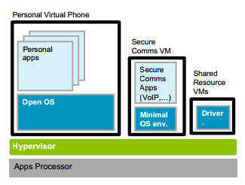
Secure communications in standard phone

Slide 31
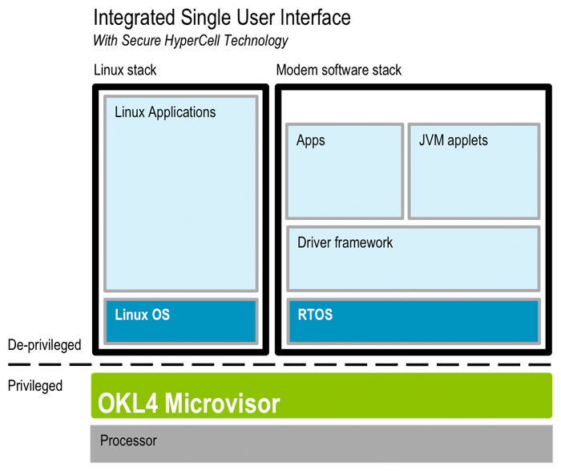
L4 Microvisor

Slide 32
The Microkernel pattern (www.vico.org)
"The Microkernel architectural pattern applies to software systems that must be able to adapt to changing system requirements. It separates a minimal functional core from extended functionality and customer-specific parts. The microkernel also serves as a socket for plugging in these extensions and coordinating their collaboration." (Buschmann, F., R. Meunier, H. Rohnert, P. Sommerlad, and M. Stal. Pattern-Oriented Software Architecture: A System Of Patterns. West Sussex, England: John Wiley & Sons Ltd., 1996)
The microkernel includes functionality that enables other components running in separate processes to communicate with each other. It is also responsible for maintaining system-wide resources such as files or processes. In addition, it provides interfaces that enable other components to access its functionality.

Slide 33
Microkernel
11/13/2018
33

Slide 34
Microkernel-based architectures
A microkernel includes mostly communication functions and a set of some fundamental services, typically functions such as process creation/deletion, process communication
All other non-essential functions are implemented as part of internal or external servers.
The client interfaces with the kernel through an Adapter (interface transformer). This routes the service request to the either the microkernel or to an external server.
The microkernel class is used mostly to establish communication and to perform very basic functions. Additional functionality is decoupled into internal servers. External servers implement their view of the microkernel as seen through its interfaces.
This decoupling makes the microkernel reusable and the operating system becomes highly extensible, we just need to add more internal or external servers.
This approach is a type of client/server system where the microkernel provides a common facility between client programs and services.
The microkernel is effectively a Reference Monitor

Slide 35
Reducing kernel mode execution
If only a few critical functions run in kernel mode security and reliability improve
Hypervisors and microvisors run in kernel mode but all other programs run in user mode
It also improves performance
Can act as a Reference Monitor (see cloud security chapter)

Slide 36
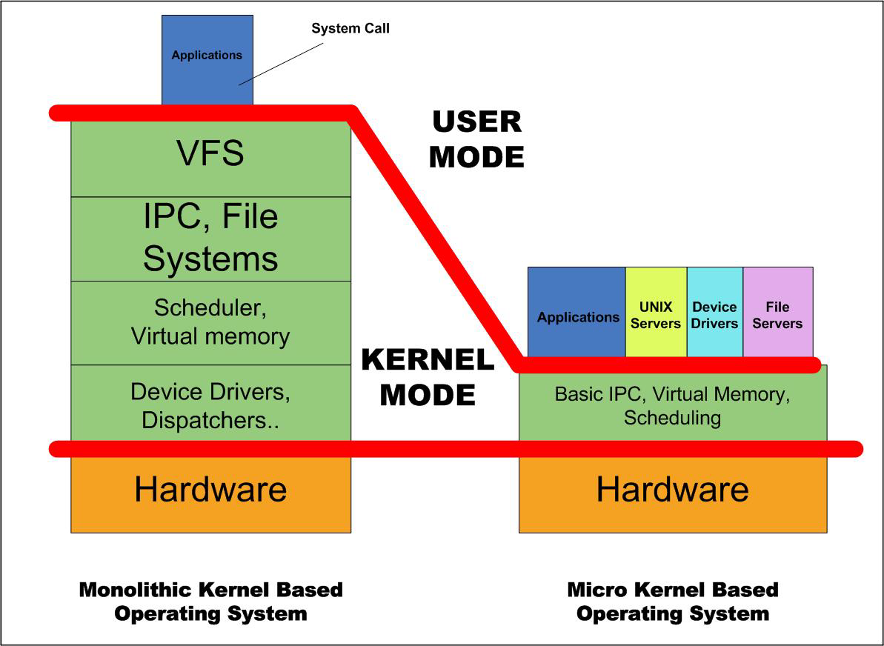

Slide 37
Hardware support: ARM architecture
The ARM is a 32-bit Reduced-Instruction Set Computer (RISC), developed by British company ARM Holdings.
It was known as the Advanced RISC Machine, and before that as the Acorn RISC Machine
They were originally conceived as a processor for desktop personal computers
The relative simplicity of ARM processors made them suitable for low power applications. This has made them dominant in the mobile and embedded electronics market

Slide 38
ARM II
The ARM architecture is the most widely used Instruction Set Architecture (ISA) in terms of numbers produced. More than a 100 billion produced by 2017.
ARM processors are used extensively in consumer electronics, including tablets, mobile phones, digital media and music players, hand-held game consoles, calculators, laptops, and computer peripherals such as hard drives and routers
There are 32 and 64-bit versions
They have security extensions

Slide 39
ARM Security
The Security Extensions (TrustZone Technology), is found in ARMv6KZ and later application profile architectures.
It provides a low cost alternative to adding an additional dedicated security core to a chip, by providing two virtual processors backed by hardware based access control
This enables the application core to switch between two states, referred to as worlds, in order to prevent information from leaking from the more trusted world to the less trusted world.
This world switch is generally orthogonal to all other capabilities of the processor, thus each world can operate independently of the other while using the same core.
Memory and peripherals are for controlling the use of media on ARM-based devices, and preventing any unapproved use of the device.

Slide 40
ARM Sec II
Typical applications of TrustZone Technology are to run a rich operating system in the less trusted world, and smaller security-specialized code in the more trusted world (known as TrustZone Software, a TrustZone optimized version of the Trusted Foundations(TM) Software developed by Trusted Logic), allowing much tighter access control for the use of media on ARM-based devices, and preventing any unapproved use of the device.
In practice, since the specific implementation details of TrustZone are proprietary and have not been publicly disclosed for review, it is unclear what level of assurance is provided for a given threat model.
See: https://www.blackhat.com/docs/us-14/materials/us-14-Rosenberg-Reflections-on-Trusting-TrustZone.pdf
As of ARMv6, the ARM architecture supports no-execute page protection, which is referred to as XN, for eXecute Never

Slide 41
ARM Virtualization extensions
The extensions only apply to non-secure mode. They introduce a new processor mode, hyp mode, which is more privileged than the existing non-secure kernel modes.
This leaves the existing kernel and user modes for unmodiﬁed guest OSes and applications, as shown in Figure 1

Slide 42
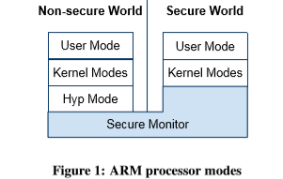

Slide 43
ARM Cortex processor architecture

Slide 44
Known uses
The OKL4 Microvisor implements a combination virtual machine monitor/microkernel (Heiser and Leslie 2010) that creates a few types of VMs. The OKL4 Microvisor supports ARM hardware virtualization extensions, as introduced in the Cortex-A15 processor. The use of hardware virtualization greatly reduces the changes required to a guest OS.
Apple phones have a Secure Enclave that runs a customized version of the OKL4 microvisor (Apple 2018). The Secure Enclave is an Apple coprocessor that has encrypted memory and a random number generator. Its function is to keep data integrity. Communication with the application processor uses an interrupt-driven mailbox.
Samsung phones’ Knox security functions use virtual machines for this separation (Samsung). Its workspace also uses two-factor authentication. ARM TrustZone Secure World is isolated by hardware and intended for sensitive software. The Secure World has a higher privilege and can access Secure and Normal World resources. TrustZone is used for purposes such as detecting modifications to the kernel.
Huawei phones use hardware-supported virtual processors using the Kylin CPU, based on the ARM architecture (Huawei 2017).
Motorola phones used the OKL4 (Geiser2009).

Slide 45
Use of multilevel models for separation of processes
For some types of protection we want to confine execution of a process in a system partition which has been assigned to a specific confidentiality or integrity level. Access from this process to other partitions (processes or data) is restricted according to the rules of a multilevel security model, where processes have sensitivity levels.
Simple security (ss) property. A subject s may read object o only if its classification dominates the object’s classification, i.e., C(s) => C(o). This is the no read-up property.
*-Property. A subject s that can read object o is allowed to write object p only if the classification of p dominates the classification of o, i.e., C(p) => C(o). This is the no write-down property.
Idea: Even if one part of the system is compromised or corrupted, other units will remain unaffected; that is, attacks or errors in a partition at some level should not propagate to other levels.

Slide 47
Use of the levels (1 is lowest)
Assume that Outside can be captured by the attacker (it is the only partition with external access)
Assign Outside to level 2 so we can control actions above and below this level
System is in level 1, so the attacker can read it but not overwrite the web pages or the CGI scripts
System Hi is in level 3 and the attacker cannot read the log. He can append information to it but not change the old information.
Inside is in level 4 and the attacker cannot read or overwrite its functions (CGI, web services,…). Same as level 3 plus gateway control

Slide 48
Process isolation
Operating systems run in different zones and are isolated by the virtualization environment
However, we still need to restrict the execution of processes within the same zone so they do not interfere with each other and do not access resources for which they are not authorized
This is done using the Controlled Execution Environment pattern (AKA sandbox)
Most operating systems in phones (e.g. Tizen) or larger systems use this pattern
Browsers also use it (to be seen)

Slide 49
The Controlled Execution Environment pattern
Intent: To control access to all operating system resources by processes, based on user, group, or role authorizations.
Context: A process executes on behalf of a user or role (a subject). A process must have access rights to use these resources during execution. The set of access rights given to a process define its execution domain. Processes must be able to share resources in a controlled way. The rights of the process are derived from the rights of its invoker.

Slide 50
Sandbox pattern

Slide 51
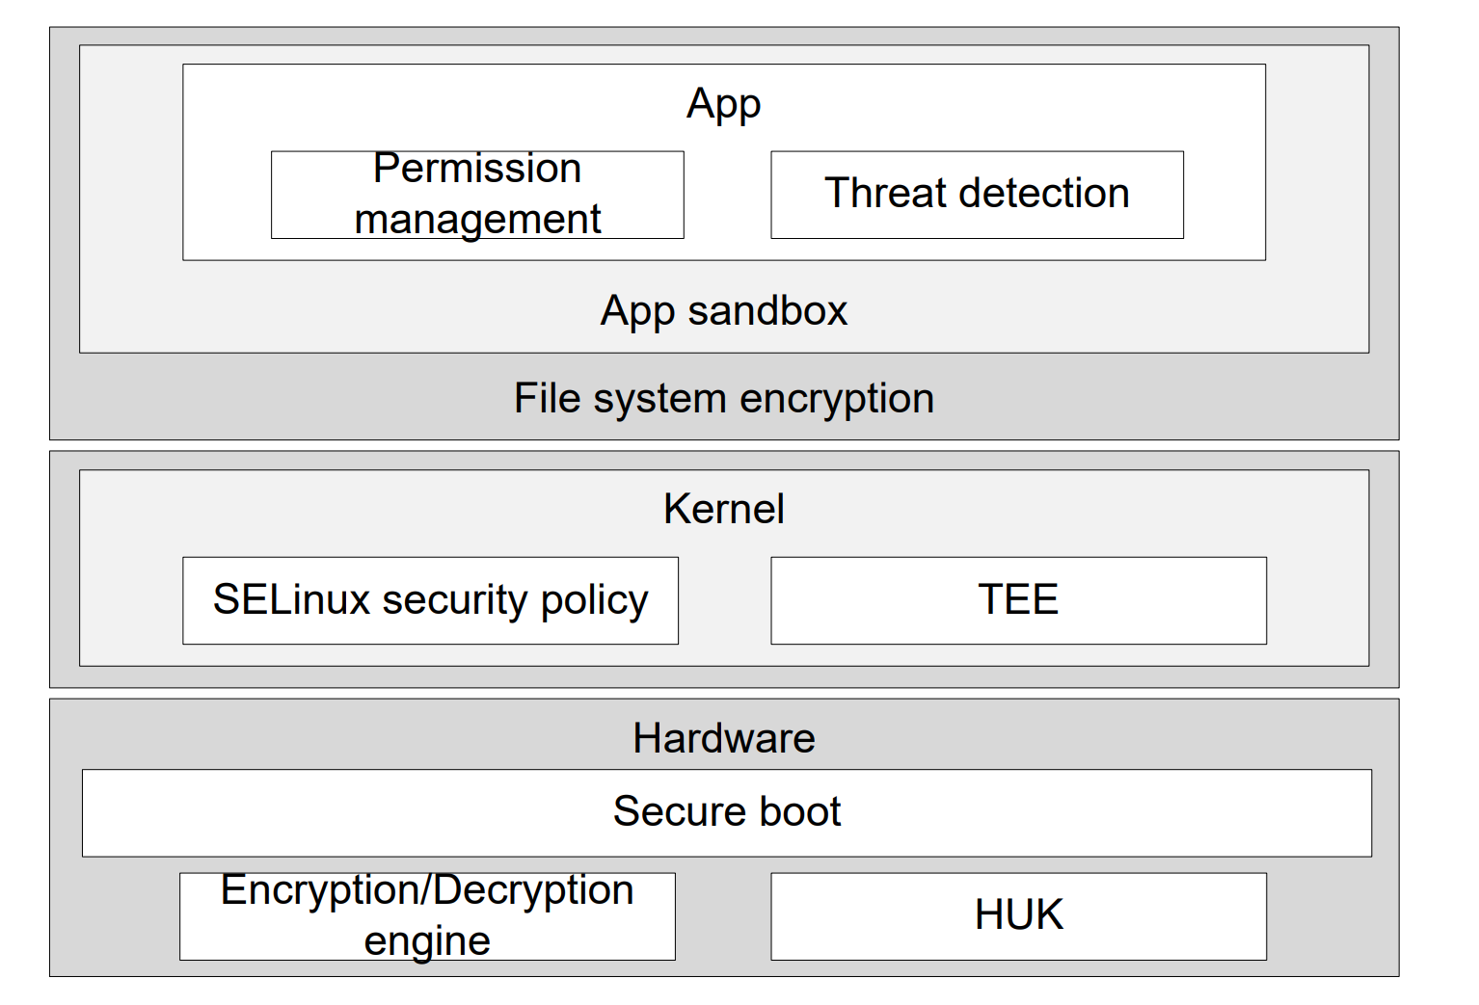
EMUI (Huawei) security architecture

Slide 52
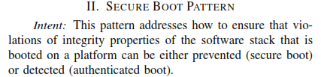

Slide 53
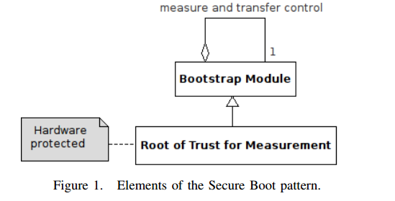
Secure Boot

Slide 54
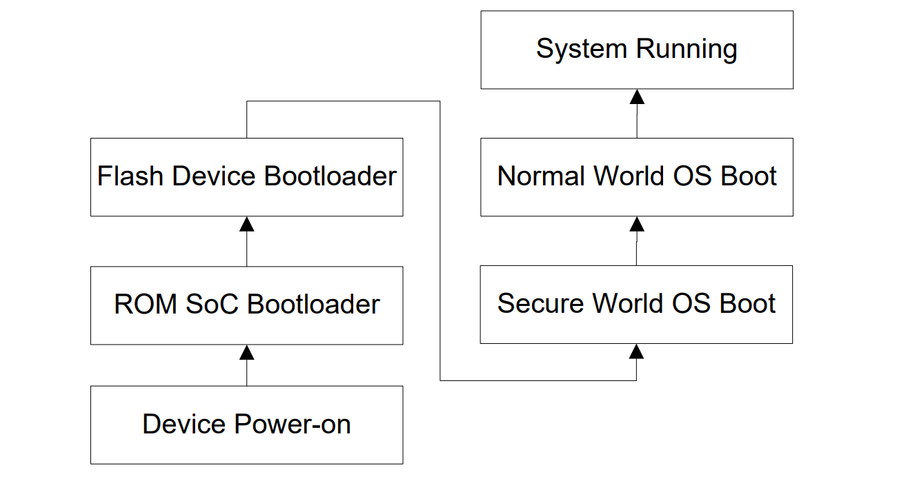
EMUI 8.0 (Huawei) Secure boot

Slide 55
Trusted Platform Module (TPM)
Also known as ISO/IEC 11889, is an international standard for a secure cryptoprocessor, a dedicated microcontroller designed to secure hardware through integrated crypto keys.
The United States Department of Defense (DoD) specifies that "new computer assets (e.g., server, desktop, laptop, thin client, tablet, smartphone, personal digital assistant, mobile phone) procured to support DoD will include a TPM version 1.2 or higher.

Slide 56
TPM functions
TPM offers facilities for the secure generation of crypto keys, and limitation of their use, in addition to a random number generator. It also includes capabilities such as:
Remote attestation – creates a nearly unforgeable hash key summary of the hardware and software configuration. The program hashing the configuration data determines the extent of the summary of the software. This allows a third party to verify that the software has not been changed.
Binding – encrypts data using TPM bind key, a unique RSA key derived from a storage key.
Sealing – encrypts data in a similar manner to binding, but in addition specifies a state in which TPM must be in order for the data to be decrypted (unsealed).

Slide 57
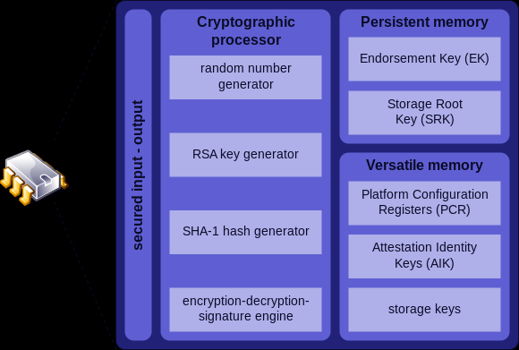
TPM structure

Slide 58
Pattern diagram of a cloud ecosystem

Slide 59
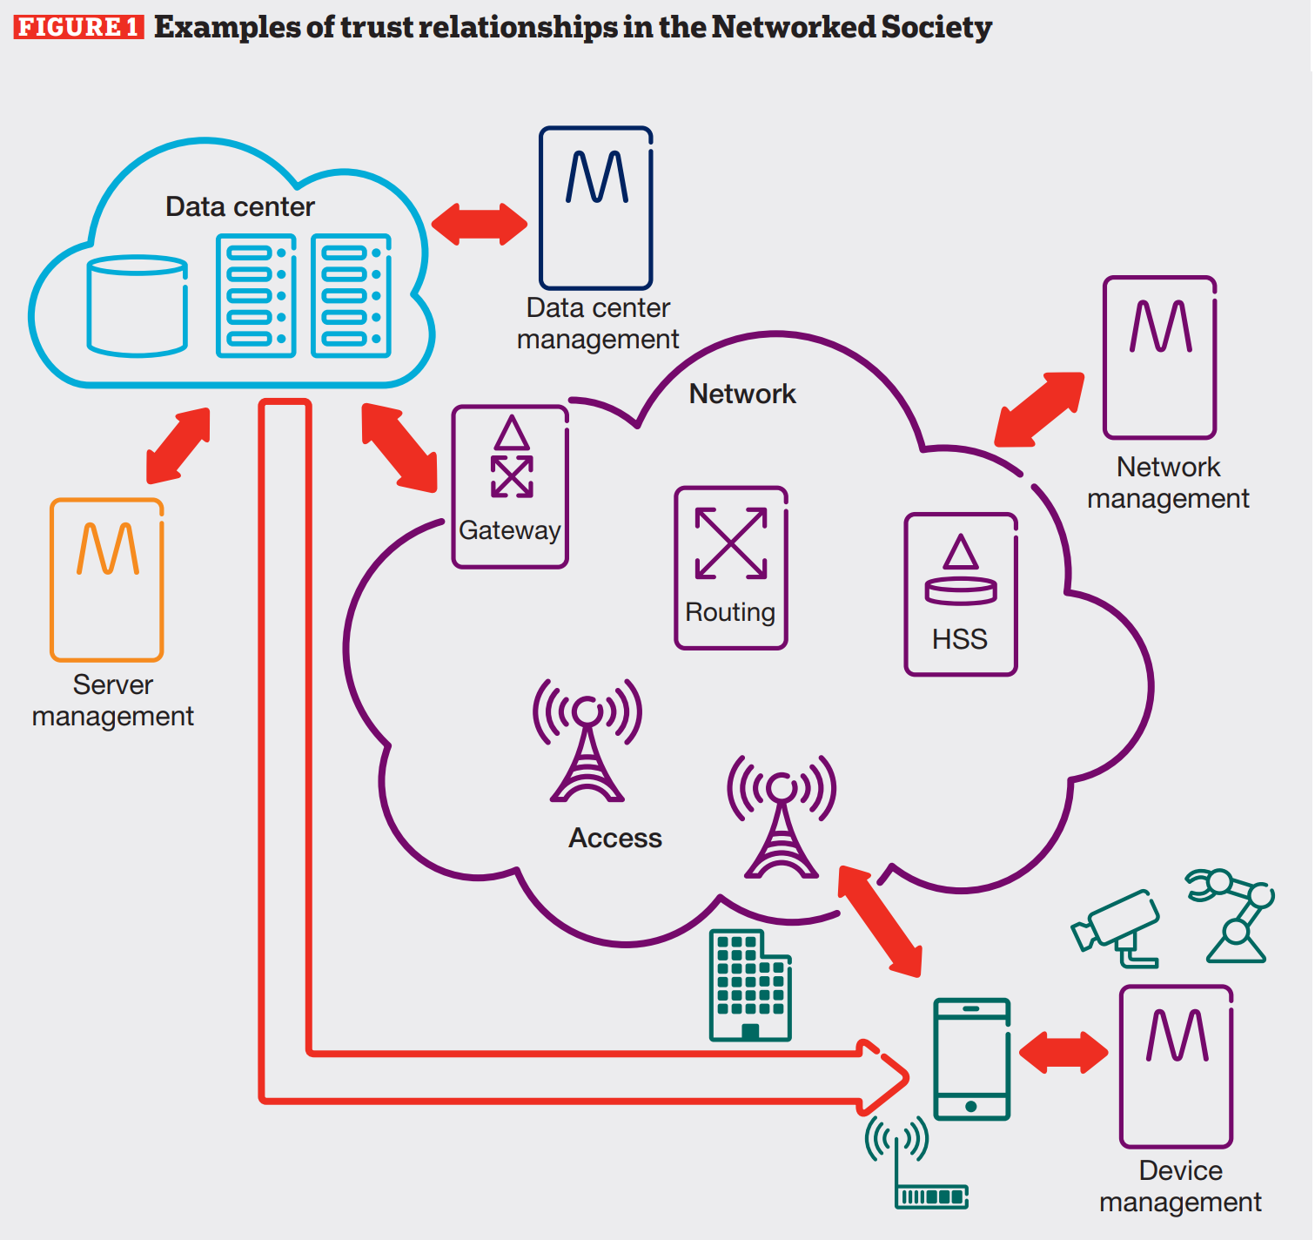

Slide 60
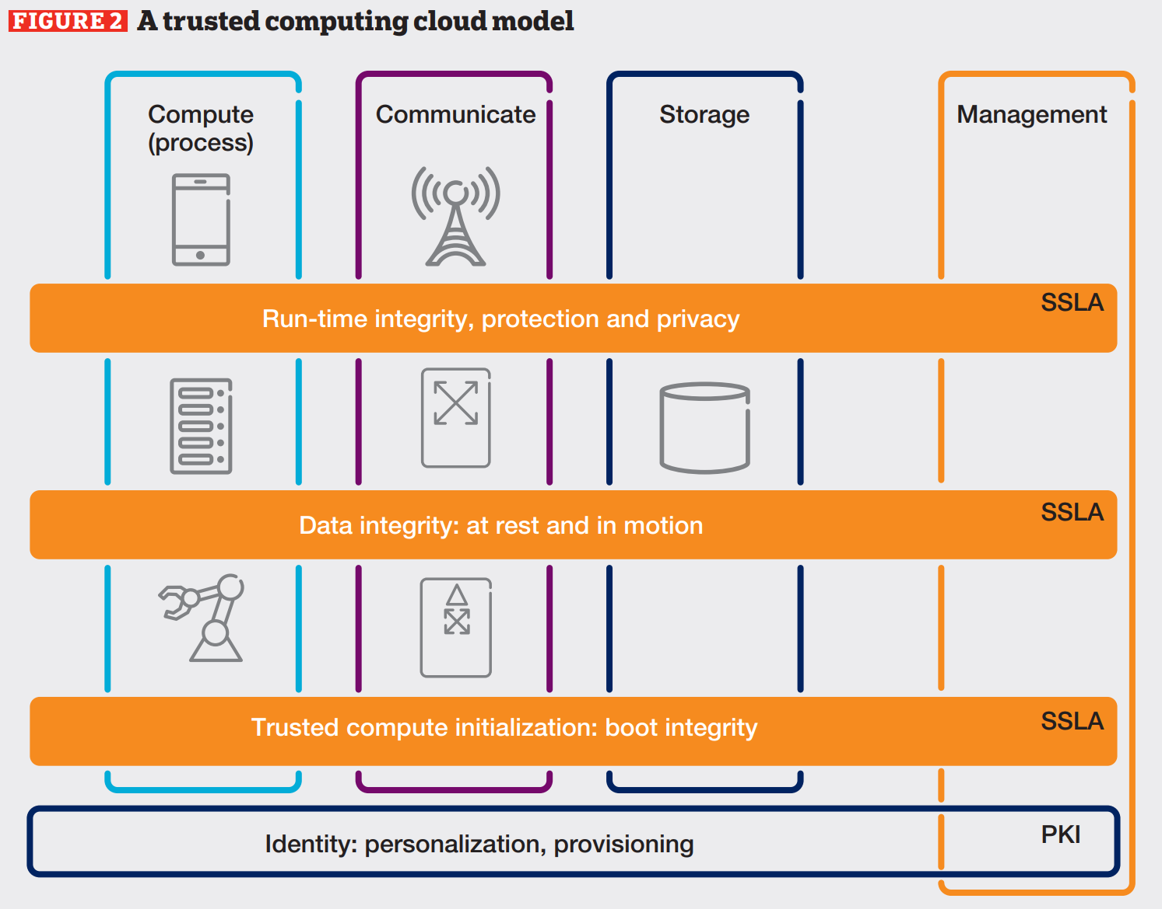

Slide 61
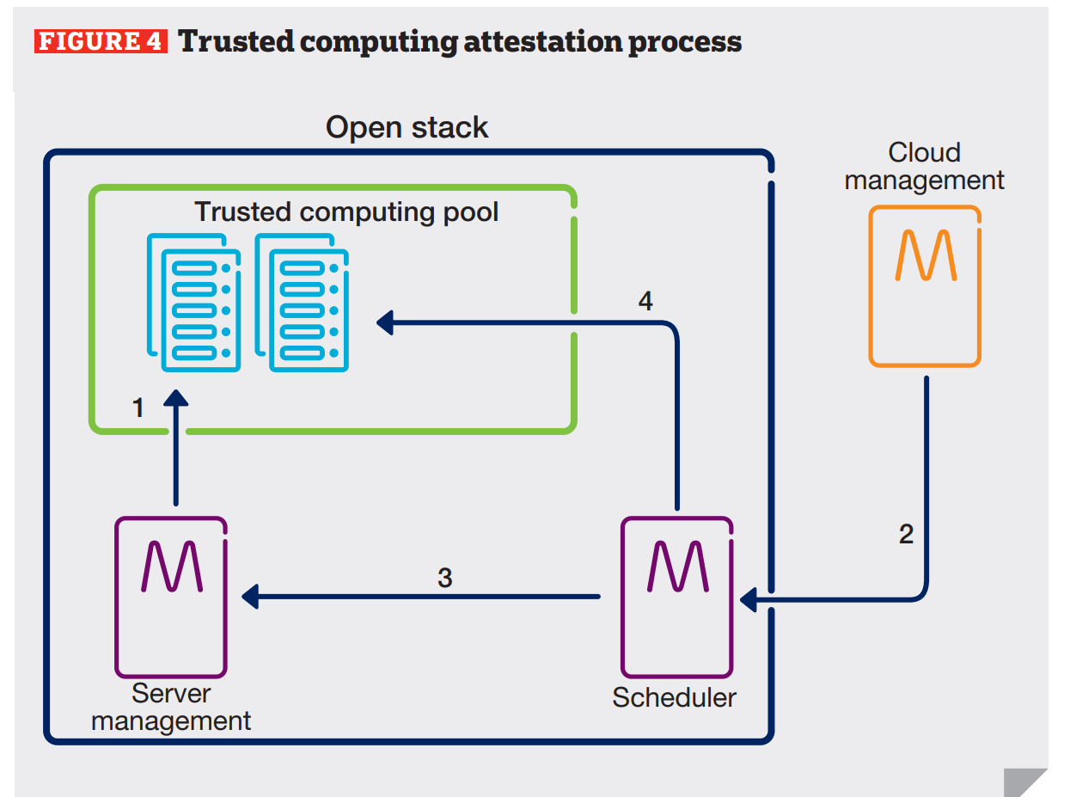

Slide 62
Information Sharing Specifications for Cybersecurity
The DHS Office of Cybersecurity and Communications, National Cybersecurity and Communications Integration Center, and US-CERT are leading efforts to automate and structure operational cybersecurity information sharing techniques across the globe:
TAXII™, the Trusted Automated eXchange of Indicator Information;
STIX™, the Structured Threat Information eXpression; and
CybOX™, the Cyber Observable eXpression.
International in scope and free for public use, TAXII, STIX and CybOX are community-driven technical specifications designed to enable automated information sharing for cybersecurity situational awareness, real-time network defense and sophisticated threat analysis.

Slide 63
TAXII and STIX
TAXII defines a set of services and message exchanges that, when implemented, enable sharing of actionable cyber threat information across organizational, product line and service boundaries. TAXII is not an information sharing program itself and does not define trust agreements, governance, or other non-technical aspects of collaboration. Instead, TAXII empowers organizations to share the information they choose with the partners they choose.
STIX is a collaborative effort to develop a standardized, structured language to represent cyber threat information. The STIX framework intends to convey the full range of potential cyber threat data elements and strives to be as expressive, flexible, extensible, automatable, and human-readable as possible. All interested parties are welcome to participate in evolving STIX as part of its collaborative community.

Slide 64
CybOX
CybOX is a standardized schema for the specification, capture, characterization, and communication of events or stateful properties that are observable in all system and network operations. A wide variety of cybersecurity use cases rely on such information including event management/logging, malware characterization, intrusion detection/prevention, incident response, and digital forensics. CybOX aims to provide a common structure and content types for addressing cyber observables across this wide range of use cases to improve consistency and interoperability.
There are interesting possibilities to relate them to misuse patterns.

Slide 65
References
M.H. Almeshekah, E.H. Spafford, “Cyber security deception”, Cyber Deception, Springer 2016, 25-52
E. B. Fernandez, Elias Bou-Harb, Virginia Romero, “A security pattern for honeypots”, 6th Asian Conference on Pattern Languages of Programs” (AsianPLoP 2017), Tokyo, Japan, March 11-12, 2017.
Michael Docking, Anton V. Uzunov, Chris Fiddyment, Richard Brain, Scott Hewett, Lee Blucher, “UNISON: Towards a Middleware Architecture for Autonomous Cyber Defence”, 2015 24th Australasian Software Engineering Conference
M. Vielberth, G. Pernul, “A Security Information and Event Management pattern”, 12th Latin American Conf. on Pattern Languages of Programs, Nov. 20-23, 2018, Valparaiso, Chile

